Slide 1
Reinforcement Learning
Prof. Tae-Hyoung Park
Dept. of Intelligent Systems & Robotics, CBNU

Slide 2
Machine Learning
Machine Learning
Supervised learning (지도학습)
입력과 출력 (정답 label) 이 쌍으로 존재하는 데이터를 이용하여 입력을 적합한 출력으로 변환하는 학습방법
Regression, classification
Unsupervised learning (비지도학습)
정답 Label 이 없는 데이터를 이용하여 데이터에 숨어있는 구조 학습
Clustering, anomaly detection
Reinforcement learning (강화학습)
에이전트(agent) 가 환경 (environment) 과 상호작용하면서 수집한 데이터를 바탕으로 더 많은 보상 (reward) 를 얻는 방법 학습
Q-learning, DQN
Notes:
학습기반, 룰기반의 알고리즘으로 구현

Slide 3
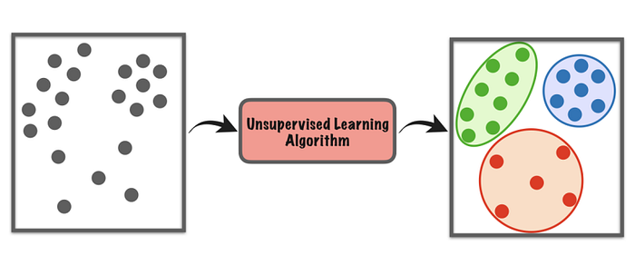
Machine Learning
Supervised learning
Unsupervised learning
Reinforcement learning
Notes:
강화학습은 Agent, Envoronment, Action등 존재함(특이점)

Slide 4
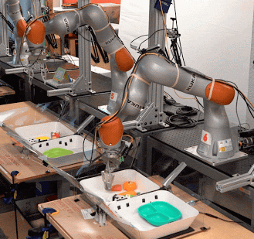
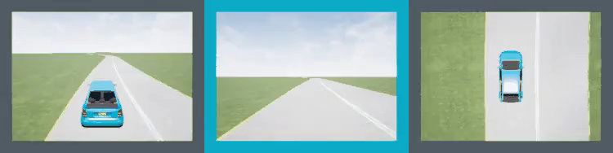
Sequential Decision-Making
Sequential decision-making problems
Playing video games or sports
Self-driving cars
Robotic manipulation
News recommendation
NLP (natural language processing)

Slide 5
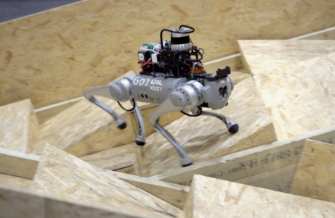
Reinforcement Learning
Agent & Environment
(ex) 로봇 보행 문제
- 목표: 로봇이 효율적으로 앞으로 나아가는 방법 학습
- agent: 로봇
- action: 팔다리 움직임 조작
- reward : 앞으로 나아간 거리
- state: 주변 환경
Action
Agent
Environment
Reward, State
Agent: action 의 주체
★ ‘참값’ (선생님) 을 가르치는 지도학습이 아님
★ 피드백 (reward) 을 받아 경험을 쌓고,
경험을 통하여 스스로 학습

Slide 6
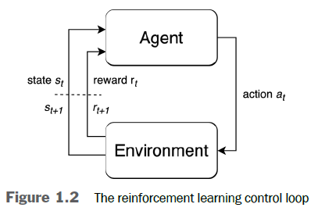
Reinforcement Learning
Reinforcement Learning
Method by which artificial agent learn to solve the sequential decision-making problem
AI + optimal control theory + Markov decision process
cycle of (state → action → reward)
Experience at time step t = $( s_{t}, a_{t}, r_{t})$
Episode: time horizons from t = 0 to when the environment terminates.
Sequence of experience over an episode
$τ=$ $\left( s_{0}, a_{0}, r_{0}\right),\left( s_{1}, a_{1}, r_{1}\right), ⋯,\left( s_{T}, a_{T}, r_{T}\right)$ : trajectory
Agent = 행동주체 (ex) robot, driver, ….
Agent’s goal is to maximize the objective by selecting good actions
Learning agent by use of reward signals which reinforce good actions

Slide 7
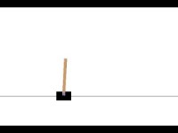
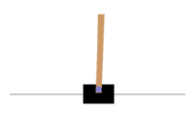
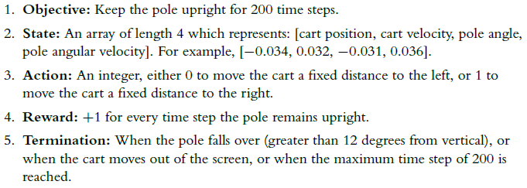
RL Examples
CartPole
https://youtu.be/SLQrHrmAaLk

Slide 8
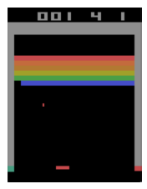
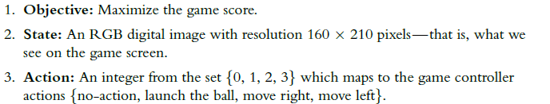

RL Examples
Atari Breakout

Slide 9
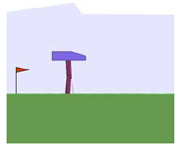
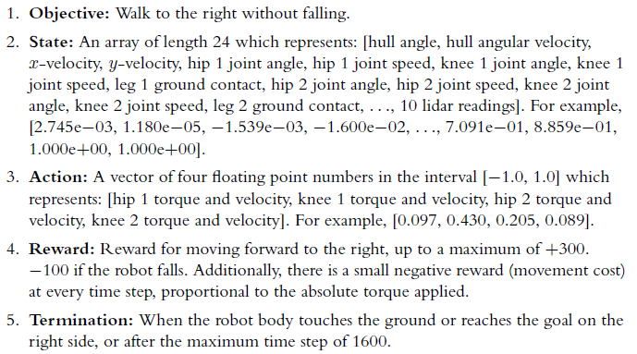
RL Examples
Bipedal Walker

Slide 10
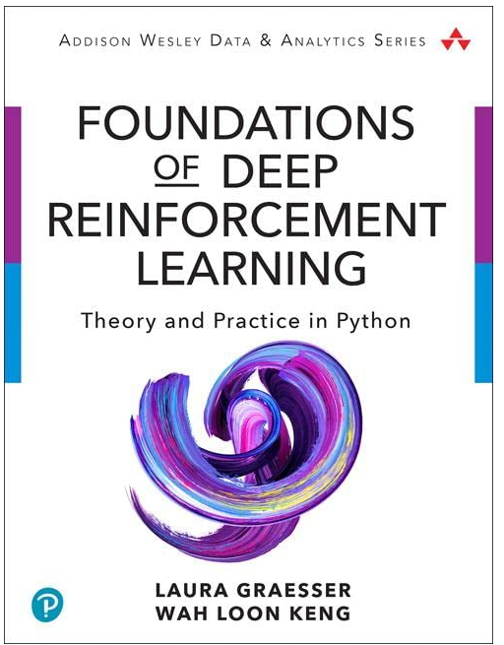
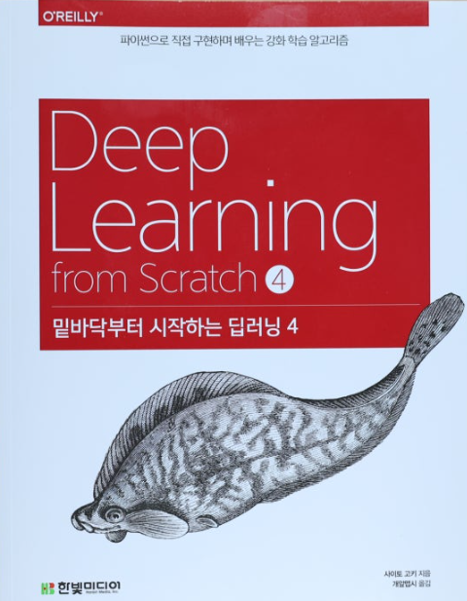
Course Outline
Textbooks

Slide 11
Course Outline
Contents
Introduction : 1 week
Markov Decision Process : 2 weeks
Dynamic Programming : 2 weeks
SARSA : 2 weeks
Q Learning: 2 weeks
DQN : 2 weeks
Policy Based Learning : 2 weeks
Advanced RL: 1 week

